Slide 1




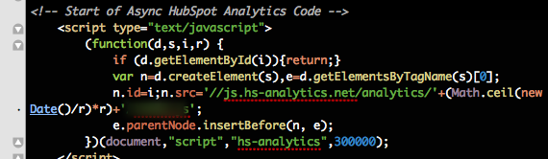
JavaScript Basics
Course Introduction
JavaScript
Basics
SoftUni Team
Technical Trainers
Software University
http://softuni.bg

Slide 2








SoftUni Diamond Partners

Slide 3


Table of Contents
Course Objectives
Course Program
Trainers Team
Examination
Learning Resources

Slide 4
Front-End Level at the Software University
36 credits
Web Fundamentals
( HTML + CSS + WordPress )
Lectures + TW + labs + exam
4 weeks * 3 times
6 credits
JavaScript
Basics
Lectures + TW + labs + exam
4 weeks * 3 times
6 credits
Advanced JavaScript
Lectures + TW + labs + exam
3 weeks * 3 times
8 credits
JavaScript Applications
Lectures + TW + labs + exam
4 weeks * 3 times
8 credits
JavaScript Frameworks
Lectures + TW + labs + exam
5 weeks * 3 times
8 credits

Slide 5

JavaScript Basics
Course Objectives & Program

Slide 6


JavaScript Basics – Course Program
Course Introduction – Course Program, Exams, Teachers, Evaluation, Resources JavaScript Introduction – Dynamic HTML, JS history, JS first steps JavaScript Tools/IDEs – JS Development Tools, Debugging Tools, Utilities
JavaScript Syntax – Data types, variables, conditional statements…
Loops, Arrays and Strings
Functions and Objects – Function scope, creating and using objects
Working with DOM and Events – Create/Edit elements, basic event handling
Teamwork Defense
Practical Exam

Slide 7

Warning: Not for Absolute Beginners
The "JavaScript Basics" course is NOT for absolute beginners
Take the "C# Basics" course at SoftUni first: https://softuni.bg/courses/csharp-basics
The course is for beginners, but requires previous coding skills
Requirements
Coding skills – entry level
Computer English – entry level
Logical thinking
coding skills
required!

Slide 8

The Trainers Team

Slide 9


Trainers Team (1)
Bogomil Dimitrov
Junior trainer @ SoftUni
Top performing student from the Software University (2014)
Nikolay Bankin
Top performing student from the Software University (2014)
Software Engineer

Slide 10

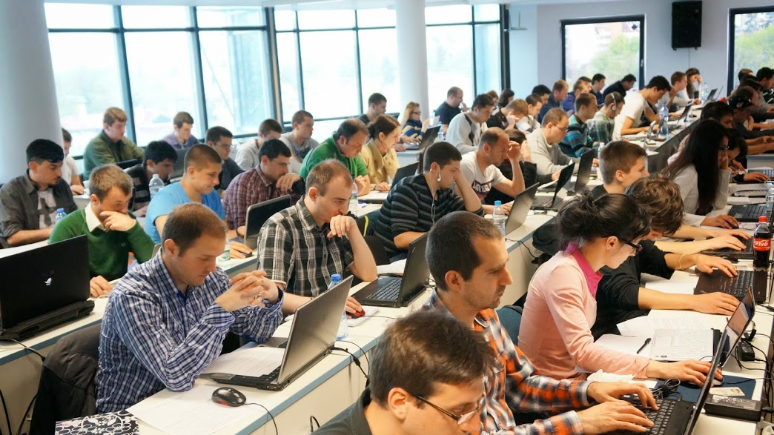
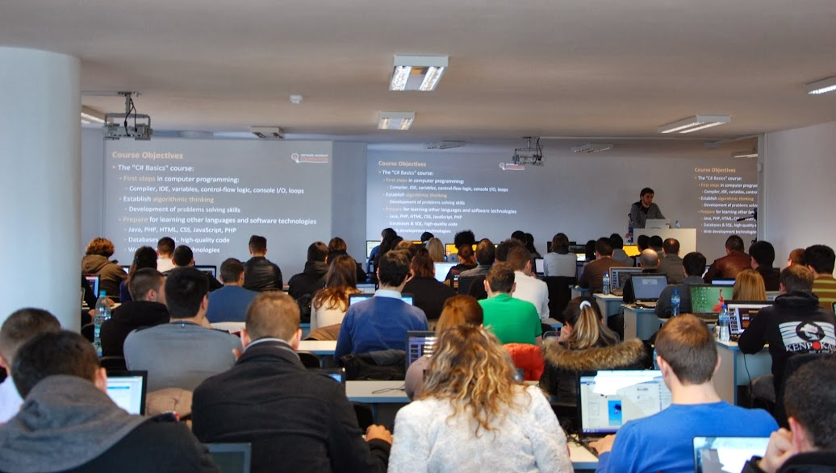
Volunteer Teaching Assistants
Volunteer teaching assistants
Developers from the software industry
Scholarship students from SoftUni

Slide 11

JavaScript Basics: More Details
Duration, Languages, Technologies

Slide 12


Training Duration – JavaScript Basics
Lectures: ~ 10 hours (onsite + YouTube videos)
Practical exercises (in class): ~ 10 hours
Homework: ~ 30-50 hours
Team project: ~ 10-20 hours
Exam preparation: 8 hours
Exam: 6 hours
Schedule: January 2016
Exam dates: 31 January 2016
Teamwork defense dates: 28 January 2016

Slide 13
Why JavaScript?
Runs both in front-end and back-end
Makes Web sites more dynamic and to build fast servers
Tons of job growth and high pay for those who know JavaScript
Node.js – 80 000% growth in demand over the last 3 years
Angular.js – 9 000% growth in demand in just last year
Open source
JS is defined as ECMAScript – free for anybody to implement
JavaScript is running everywhere: browsers, mobile phones, etc.

Slide 14



Why English?
Why the slides are in English?
English is the native language of the software engineers
Specific terminology should be in English
Translations are inaccurate and funny
Just learn English!
No excuses

Slide 15



JavaScript Basics
Evaluation Criteria

Slide 16


Scoring System for the “JavaScript Basics”
Exam – 80%
Homework + evaluation – 5% + 5%
Team work: 10%
Bonuses: up to 10%
Presence in class: 5% (onsite students only)
Forum bonuses
Others

Slide 17
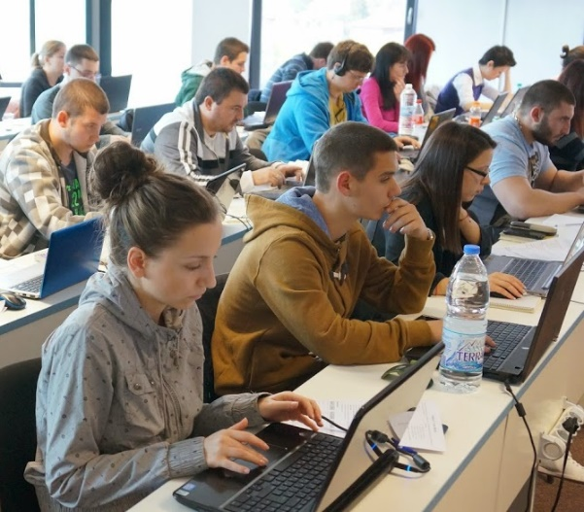

JavaScript Exam
Practical programming exam
4 practical problems for 6 hours
1 easy, 2 with loops, 1 with arrays / strings
You should code in JavaScript
Automated judge system with real-time feedback
http://judge.softuni.bg
Solutions are evaluated for correctness only
Code quality is still not measured

Slide 18

Homework Assignments
Doing your homework is very important!
Programming can only be learned through a lot of practice!
You should write code every day!
Each lecture is followed by a few exercises
Try to solve them in class
The rest are your homework
Homework assignments are due in 6 days after each lecture
Submission will be accepted through our web site: softuni.bg

Slide 19

Homework Peer Reviews
Give feedback to a few random homework submissions
Students submit homework anonymously
Please exclude your name from the submissions!
For each homework submitted
Students evaluate 3 random homeworks
From the same topic, after the deadline
Give written feedback, at least 200 characters
Low-quality feedback → report for punishment
Everyone will get feedback for their homework

Slide 20





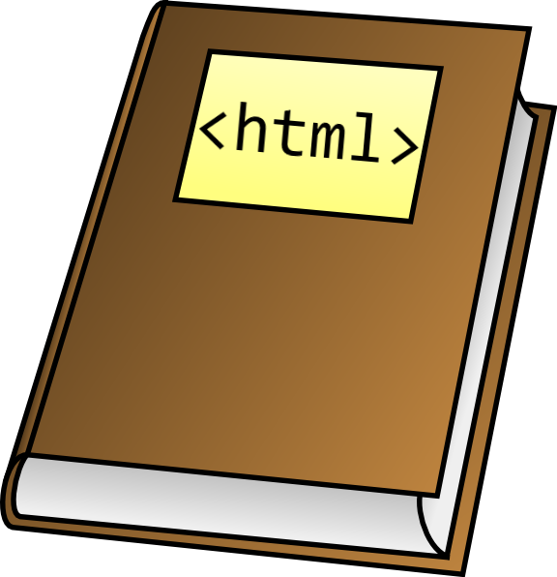



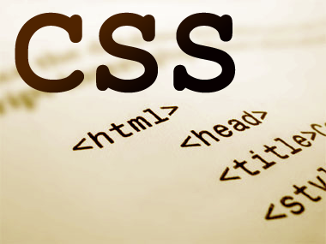
Resources
What We Need Additionally?

Slide 21

Course Web Site & Forums
The JavaScript official web site:
Register for the "Software University Forum":
Discuss the course exercises with your colleagues
Find solutions for all course exercises
Share source code / discuss ideas / help each other
https://softuni.bg/courses/javascript-basics/
https://softuni.bg/forum

Slide 22



JavaScript Basics Slides and Videos
All lecture slides, videos, homework assignments, projects and other resources are open content, available for free
Visit the course web site to access the course resources

Slide 23


JavaScript Resources
Mozilla Development Network (MDN)
https://developer.mozilla.org
Web Platform
http://www.webplatform.org
JavaScript Books
JavaScript: The Definitive Guide
JavaScript: The Good Parts

Slide 24

Software University Learning System (SULS)
Software University Learning System (SULS)
www.softuni.bg
Important resource for students
Homework submissions
Homework check-up
Exams and results
Reports about your progress
…

Slide 25



Recommended Software
Microsoft Visual Studio 2015 or Visual Studio Community
WebStorm
Sublime Text
Komodo IDE
NetBeans

Slide 26


Summary
The “JavaScript Basics" course teaches
The first steps in JavaScript
Training program
Data types and variables, conditional statements, loops, arrays, using objects, DOM, events
Practical exam
Form image to JavaScript Basics + score system
Learning resources
Lectures, videos, software, books, forum
JS Basics

Slide 27
JavaScript Basics – Course Introduction
https://softuni.bg/courses/javascript-basics

Slide 28
License
This course (slides, examples, demos, videos, homework, etc.) is licensed under the "Creative Commons Attribution-NonCommercial-ShareAlike 4.0 International" license
Attribution: this work may contain portions from
“JavaScript Basics" course by Telerik Academy under CC-BY-NC-SA license

Slide 29






Free Trainings @ Software University
Software University Foundation – softuni.org
Software University – High-Quality Education, Profession and Job for Software Developers
softuni.bg
Software University @ Facebook
facebook.com/SoftwareUniversity
Software University @ YouTube
youtube.com/SoftwareUniversity
Software University Forums – forum.softuni.bg

